Slide 1
Presents
OO Programming with Java
Annotations
Notes:
Annotations
Module 17

Slide 2
Learning Objectives
Understand what Annotations are and why they are needed
Learn how Annotations are declared
See the different types of Annotations
Show where and how Annotations are used in code

Slide 3
Why Annotations?
Many Application Programming Interfaces (API) require a lot of “boilerplate” code.
  Programs have information stored in comments e.g. author, date created, etc. (e.g. Javadoc)
  Class configuration information in external xml files
Annotations is a facility to provide meta information about a class or its members within the Java code itself
Advantage is that annotation processing tools can scrape the annotation from the code and find out the meta information about the class/method/field

Slide 4
Common Annotations
Annotation Environment Support and Packaging
  The JSR targeted Annotations both in the Standard as well the Enterprise Environments.
  The packages that contain the annotations are javax.annotation and javax.annotation.security

Slide 5
Annotations and Java Code
Annotations provide information in the Java source code that is independent of the code and has no direct impact on the code.
Common uses of Annotations are:
  Provide information for the compiler – suppress warnings, detect errors
  Compile and/or deployment time generation of additional artifacts (e.g. xml files, class files)
  Runtime settings – some types of annotations are available to the application at runtime
  To avoid developers from defining their own common type of annotations which will result in having larger number of duplicates.

Slide 6
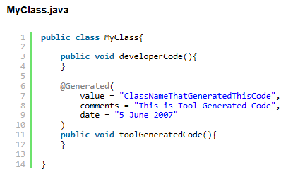
@Generated Annotation
Not all the source files or the source code in an application is hand-written by Developers. With the increasing number of Tools and Frameworks, most of the common Boiler-Plate Code is generated by the Tools or the Frameworks itself if they have been properly instructed. Such Tool Generated Code can be marked with @Generated Annotation.
Notes:
The value for the @Generated Annotation would be usually the class name that generated this code. Optionally, comments and date can be given to add more clarity to the generated code. Note this @Generated Annotation is not limited to a method definition, it can also be defined for Package Declaration, Class Declaration, Interface Declaration, Local Variable Declaration, Field Declaration, Parameter Declaration etc.

Slide 7
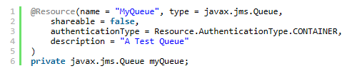
@Resource and @Resources Annotation
Any Class or Component that provides some useful functionality to an Application can be thought of as a Resource and the same can be marked with @Resource Annotation.
This kind of Annotation can be seen normally in JEE Components such as Servlets, EJB or JMS. For example consider the following code snippet,
Notes:
Queue is a class available as part of JMS API and it serves as a target for Asynchronous Messages being sent by Applications. The various properties to note in @Resource Annotation are: ‘name’ which is the JNDI Name of this resource, ‘type’ which is the type of the resource which usually points to the Fully Qualified Class Name, ‘shareable’ which tells whether this resource can be shared by other components in the Application or not, ‘authenticationType’ which indicates the type of authentication to be performed either by the Container or by the Application and the Possible values are AuthenticationType.CONTAINER and AuthenticationType.APPLICATION and ‘description’ which is a string that describes the purpose of this resource.
When the Application containing the @Resource Annotations are deployed to a Server, the Container will scan for all the Resource references during the time of Application loading and then will populate the @Resource References by assigning new instances.

Slide 8
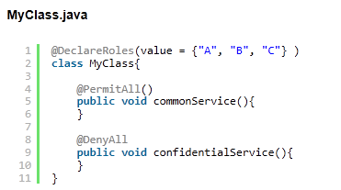
Role Based Annotations
A Typical Application is accessed by a wide range of Users and Users themselves fall into Several Roles.
  The Annotations @DeclareRoles, @RolesAllowed, @PermitAll, @DenyAll and @RunAs are Role-Based Annotations
Notes:
It is inferred that commonService() method can be accessible by all Users irrespective of their Roles as it is marked with @PermitAll() annotation and no one can access the confidentialService() because it has been marked with @DenyAll() annotation.

Slide 9
Declaring an Annotation
Annotation is a special interface where the @ sign precedes the keyword interface.
Annotation body may contain “method declarations” expected for annotation.
  Methods may not contain parameters.
  Methods may not have throws clauses.
  Return type must be one of these types: primitives, String, Class, Enum, or an array of these types.

Slide 10
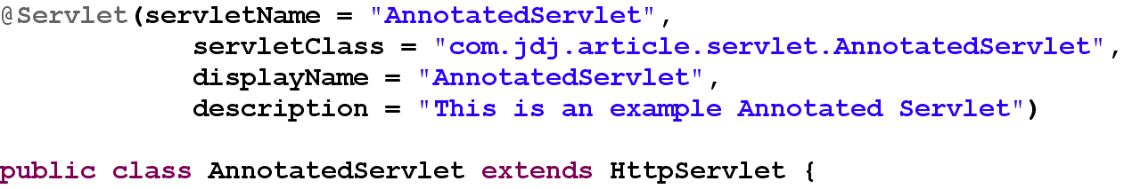
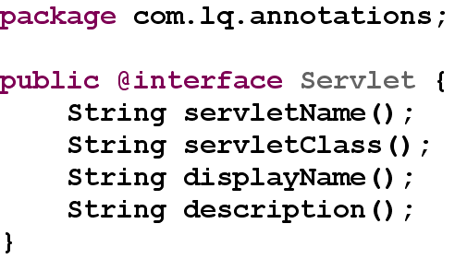
Where in Code?
The annotation appears by convention on its own line.
  Parenthesis may wrap elements of name/value pairs (a single value may be unnamed). In use:
  Declaration

Slide 11
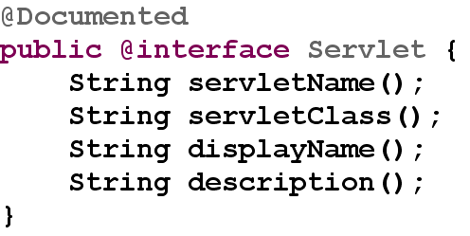
Annotation vs. Javadoc
Javadoc is an early type of comment-driven annotation.
  Javadoc was not intended to be extensible.
  The Java compiler does not process Javadoc
Annotation information may be added to Javadoc.
  @Document annotation – a meta-annotation will cause Javadoc compiler to add that annotation to the generated Javadoc.

Slide 12
Annotation Types
Three types of annotations:
  Marker annotations – no annotation elements, just a name.
    @Deprecated
  Single element annotations – one annotation element only. Allows the use of “shortcut” annotation declaration
    @Target(ElementType.Method)
  Full-value annotations – multiple annotation elements. Complete naming of the elements required.
    @MyClassAnnotation(name=“myClass”,type=“view”)

Slide 13
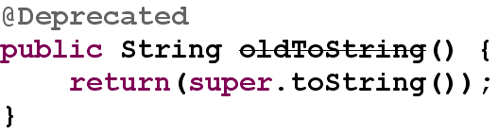
@Deprecated Annotation
@Deprecated
  Use of a program element annotated @Deprecated is discouraged.
  Tools warn when a deprecated program element is used or overridden in non-deprecated code.

Slide 14
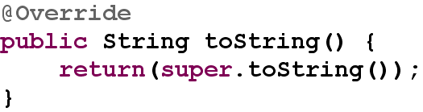
@Override Annotation
@Override
  Indicates a method is intended to override a method declaration in a superclass.
  If a method is annotated @Override but does not override a superclass method, compilers will generate an error message.

Slide 15
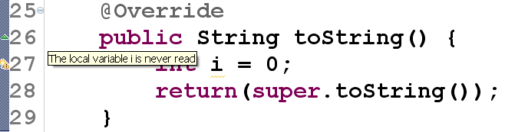
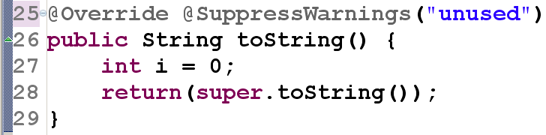
@SuppressWarnings Annotation
Causes the compiler to suppress the display of warnings in code.
  A single value is supplied in the declaration of the annotation – the type of warning to suppress.
Notes:
@SuppressWarnings(“all”)will suppress the display of all warnings.
The values of the warnings to suppress are compiler-specific.

Slide 16
Meta-annotations
There are annotation types called meta-annotations as they are used to annotate other annotation types.
The standard list includes:
  @Target – specifies constraints on annotation use.
  @Retention – declares where the annotation is visible.
  @Inherited – make annotation values available to subclasses.
  @Documented – make the annotation part of the using element’s public API.
  @Repeatable – marks an annotation as being repeatable on an element. New to Java 8.
Frameworks may declare other meta-annotations. For example, JSR-330’s @Qualifier is considered a meta-annotation.
Notes:
Indicates the kinds of program elements to which an annotation type is applicable.
If a Target meta-annotation is not present on an annotation type declaration, the declared type may be used on any program element.
If such a meta-annotation is present, the compiler will enforce the specified usage restriction.

Slide 17
Retention Meta-annotation Type
Different annotation types have different purposes.
  Some are intended for use with the compiler; others are meant to be reflected dynamically at runtime.
Value of the java.lang.annotation.RetentionPolicy enum constants determine the scope of the annotation.
  RetentionPolicy.SOURCE - the annotation will not be included in the class file.
  RetentionPolicy.CLASS - the annotation will be included in the class file, but cannot be read reflectively.
  RetentionPolicy.RUNTIME - the annotation can be reflected at runtime.
Notes:
Indicates how long annotations with the annotated type are to be retained.
If no Retention annotation is present on an annotation type declaration, the retention policy defaults to RetentionPolicy.CLASS.

Slide 18
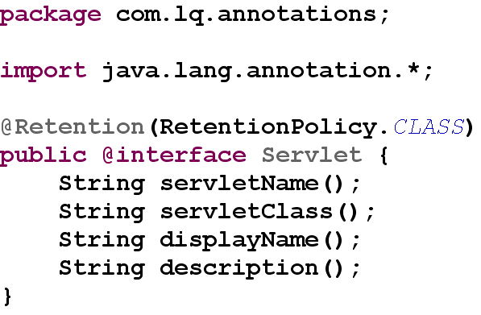
Retention Meta-annotation Type
Example of use – eliminating access to annotation elements at run-time.

Slide 19
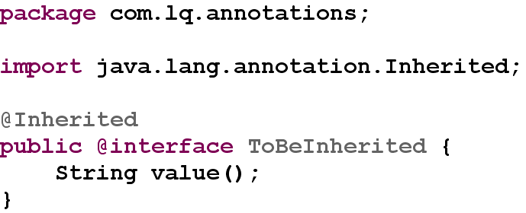
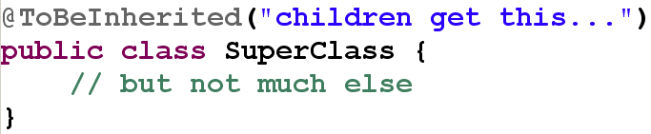
Inherited Meta-annotation Type
Example of use. The value annotated in SuperClass will be accessible in all it’s children. Declaration:
Use:

Slide 20
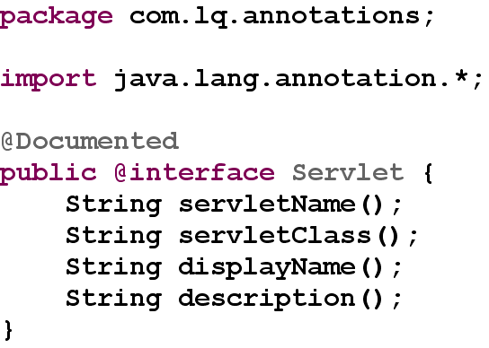
Documented Meta-annotation Type
Example – where used, the annotation becomes part of the public Javadoc:
Notes:
Indicates that annotations with a type are to be documented by javadoc and similar tools.
If a type declaration is annotated with @Documented, its annotations become part of the public API of the annotated elements.

Slide 21
Summary
Annotations are a powerful meta-facility of the Java programming language.
  A formal mechanism for specifying code-based program meta-information.
  Allows in-line specification of information that is consumed by external sources.
  Meta-information may be made available in source and class files and as necessary, at runtime.
  Standard annotations provide mechanism to add commonly-used meta-information using standard names.
  Annotations can be limited to specific types of Java code elements.
  Annotation values are by default not available at runtime nor, by default, available to subtypes.

